Slide 1
First Wave Predicting the Depth of Penetration Past the Bifurcation Point

Slide 2
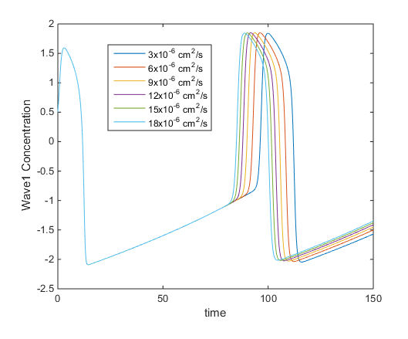
Frist Wave profile at bifurcation point
Given some x point (the bifurcation point) what does the first osculation
look like when changing the amount of Diffusion D
Increasing
Diffusion

Slide 3
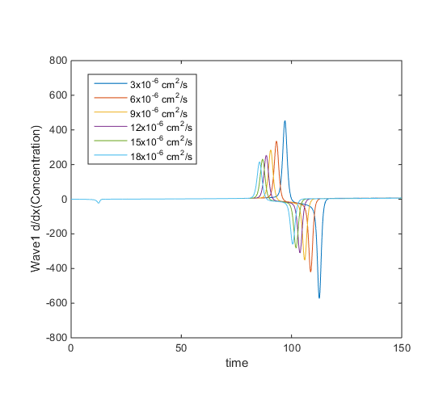

Rate of change Concentration in x
Take the previous and find the rate of change
$\frac{∂Φ}{∂x}$
Increasing the diffusion
Reduced the maximum
Change in concentration
Increasing
Diffusion

Slide 4
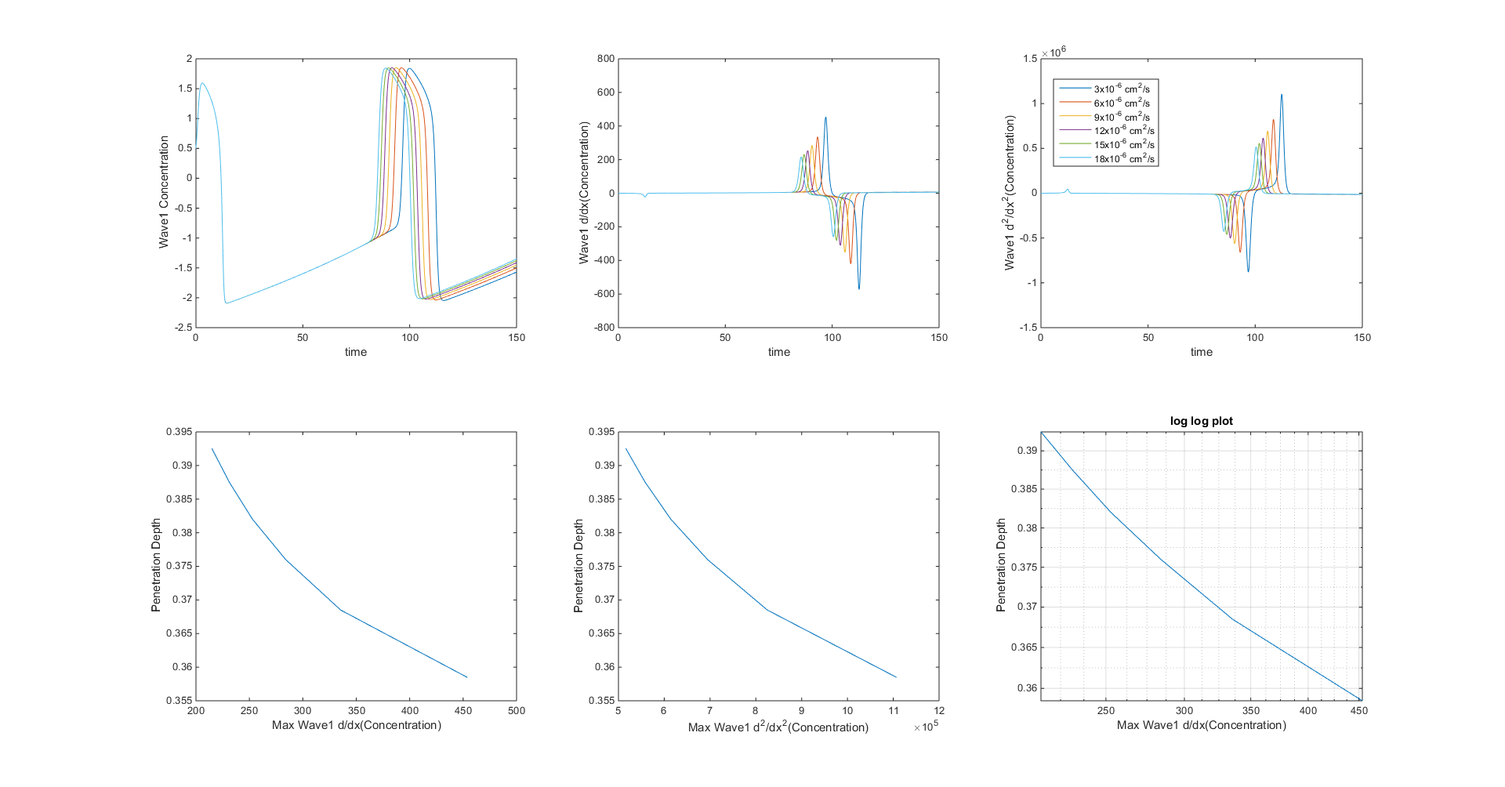
Penetration depth function of Max rate of change in x
ie: The less the diffusion the larger the maximum rate of change at the bifurcation point the further it penetrates

Slide 5
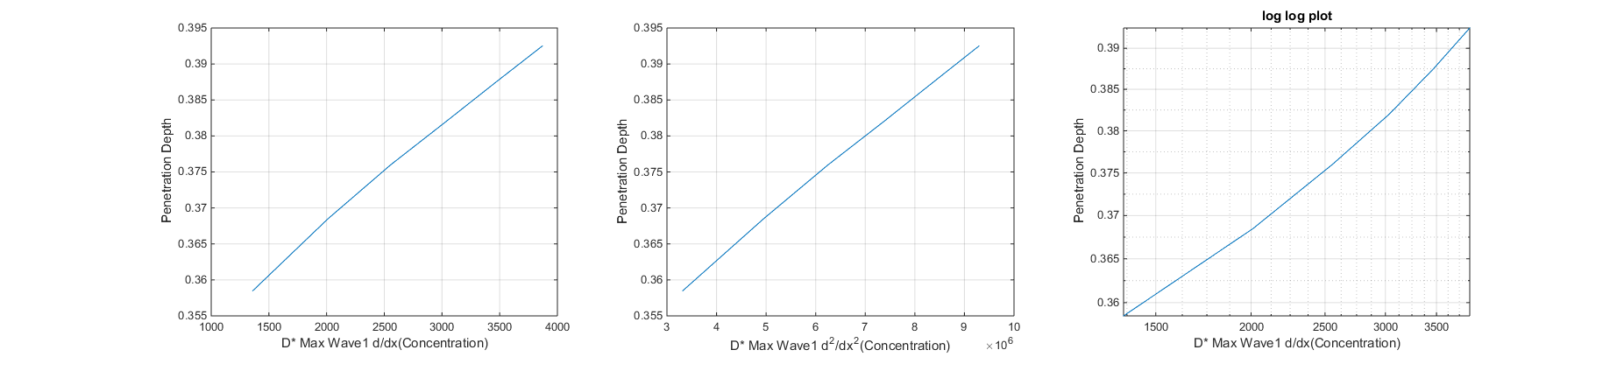
(Penetration depth) function of (Max rate of change in x * Diffusion)

